Slide 1
DEPRESSION CHATBOT INTEGRATION IN SOCIAL MEDIA

Slide 2
SITUATIONAL DEPRESSION
Notes:
A mental disorder that takes place even without any history of depression within the family.
These can occur when a person cannot cope up from negative situations.

Slide 3
Virtual Mental Health Support
Virtual Reality
EMMA’s World
Automated Conversational Agents
Woebot
Panoply
Shim
Notes:
EMMA’s world is a VR software targeted to persons who has post-traumatic stress disorder or PTSD.
What this software does is depict real life situations wherein the patients interact with real-time virtual elements
It uses positive psychology as basis for depicting the stressful situations.
Positive psychology’s basic concept is to make the patient accept his past and give hope for the future.
The software will create stressful situations in order to study or examine how the patient reacts.
The patient will then confront the problem, make decisions, and be prepared the next time this kind of situation comes.
This is to enhance the natural ability of humans to resist in depression, and learn from it.
Automated Conversational Agents
These agents were developed for a cost-efficient mental health care service mainly targeted to the wide audience of online engagements.
According to one study, these automated conversational agents are good mediums for applying cognitive-behavioral therapy.

Slide 4
ARTIFICIAL NEURAL NETWORKS
Notes:
Inspired by the structure of the human brain to solve perplex problems
Problems involve clustering, classification, pattern recognition, etc
Series of layers
Input, hidden, output
Nodes per layer has numerous interconnection
Has weight in each connection
Are adjusted when the gathered data is to be fed in the process of training
Weights are randomly assigned and changed during training

Slide 5
Artificial Intelligence Approach to Classify Unipolar and Bipolar Depressive Disorders
EEG (Electroencephalogram) signals
PSO for feature selection
Reduction of features in the increase of classification accuracy
Using back-propagation neural network to minimize the error value and modify the weights between the last hidden layer and the output layer.
The study concluded that it has the potential to be used as a clinical tool in classifying UDs and BDs.
Notes:
They were able to classify 31 bipolar and 58 unipolar subjects with an overall accuracy of 89.89%
Before and after feature selection classification accuracies:
Bipolar
From 64.52% to 83.87%
Unipolar
From 77.59% to 93.10%

Slide 6
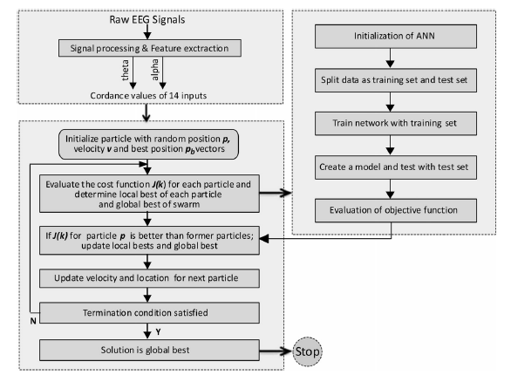
Flow chart of hybrid PSO-ANN feature selection from the study of “Artificial Intelligence Approach to Classify Unipolar and Bipolar Depressive Disorders”

Slide 7
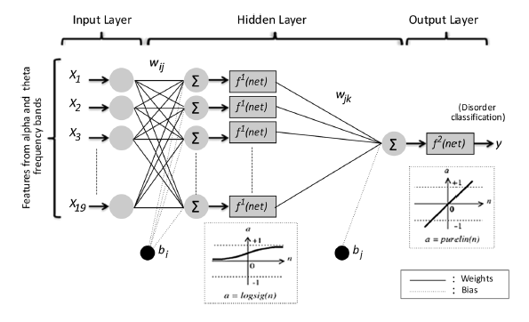
Structure of used back-propagation neural network from the study of “Artificial Intelligence Approach to Classify Unipolar and Bipolar Depressive Disorders”

Slide 8
CHATBOTS
Notes:
Programs from a computer that imitates how a human would converse in reality.
Inputs are natural language text
Would give a response that would closely resemble how an intelligent being should respond

Slide 9
Artificial Intelligence-Assisted Online Social Therapy for Youth Mental Health
Chatbots can guide the user in expressing their emotions, and what kind of therapy they would like to be in.
They can also make conversational searches in creating a sense of connectivity and personalization from the user’s input.
Researchers say that users are more open with their personal life to machine interfaces.
At its current development, it only handles social therapy and not yet close as to what therapists would do in addressing users with mental health issues.

Slide 10
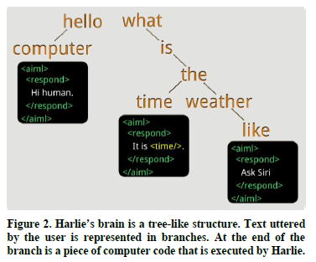
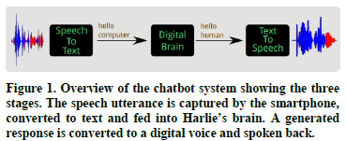
Virtually there- Chatbots for Mental Health Support
HARLIE (Human and Robot Language Interaction Experiment)
AIML (Artificial Intelligence Markup Language)

